Slide 1
Become Infineon portfolio expert in 60 seconds
Vasily Basov

Slide 2
How to become expert in one minute
10.000 Infineon products for dozens of application areas
Sales professionals need to offer a customer optimal solution quickly without referring to the Internet or contacting engineers
Question: How much time of studying, trainings and practicing is needed to become familiar with Infineon portfolio?
Answer: 60 sec *
*60 seconds is needed to download and start Smart Product Selection Map

Slide 3

What's the idea?

Slide 4


Actual information from Infineon’s website is automatically collected in a local database that does not require an Internet connection during further use.

Slide 5
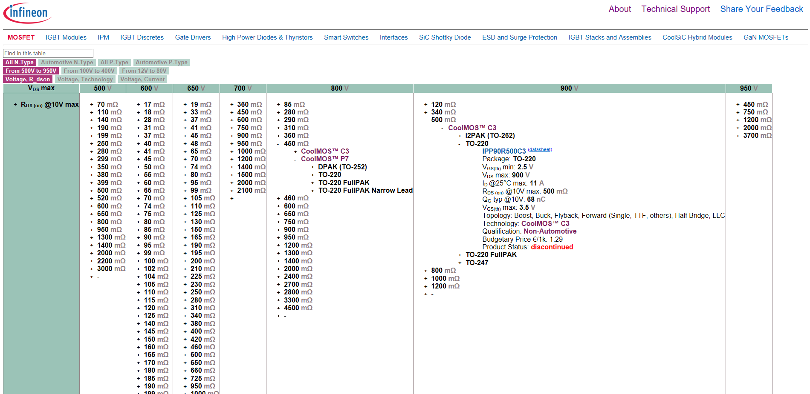
1. Select product category
We sorted components into large categories. Then we created separate interactive page for each category.

Slide 6
2. Choose viewpoint
Instantly switch views of the table, exploring the portfolio in terms of various parameters. This gives a better understanding of the internal structure of the product portfolio, shows the areas of application of various technologies.

Slide 7
3. Travel through the parameter tree
Clicking on the table cells, you move through the component parameter tree, choosing a branch according to your technical requirements, up to a particular part number

Slide 8

How to start?

Slide 9
Instruction
The tool does not require any installation of additional programs on your computer. It is enough to copy the folder with the tool in a convenient place and open the start page (index.html) in a web browser.
Download the latest version of the tool from myInfineon OR from github.com:
Option 1 (recommended) - myInfineon: Login to myInfineon, on the right panel open Simulation and Tools menu, Click on Smart Product Selection Map
Option 2 Github: Download zip file at https://github.com/vbasov007/Smart_Product_Selection_Map/archive/master.zip
Unzip the archive to a convenient place.
Go to the folder and open the index.html file in the browser (supported: Chrome, Firefox, Opera, Safari and EDGE).

Slide 10
Vasily.Basov@infineon.com
Please send me your feedback, comments, and suggestions!

